Slide 1
Introduction to R

Slide 2
Cutting-edge training delivered by leading experts in the field of data analytics brought to you by the Business and Local Government Data Research Centre
Exploring data
Enhancing knowledge
Empowering society
Offering grant funded data analytics research projects, training, events, webinars and data consultation services.
To find out more please contact Laura.brookes@essex.ac.uk

Slide 3
Agenda
Introduction
R-Syntax, Data structures & types
Data import
Creating, amending, exporting data frames
Type coercion
Loops and conditions

Slide 4
Introduction to the session
For the hands-on session visit the following web page: https://philippbroniecki.github.io/suffolk2019/

Slide 5
What is R?
An environment for statistical computing and graphics
It is free
It packs powerful graphical facilities
It is a simple and effective programming language
Most statistical models are already implemented
New models are often implemented in R first

Slide 6
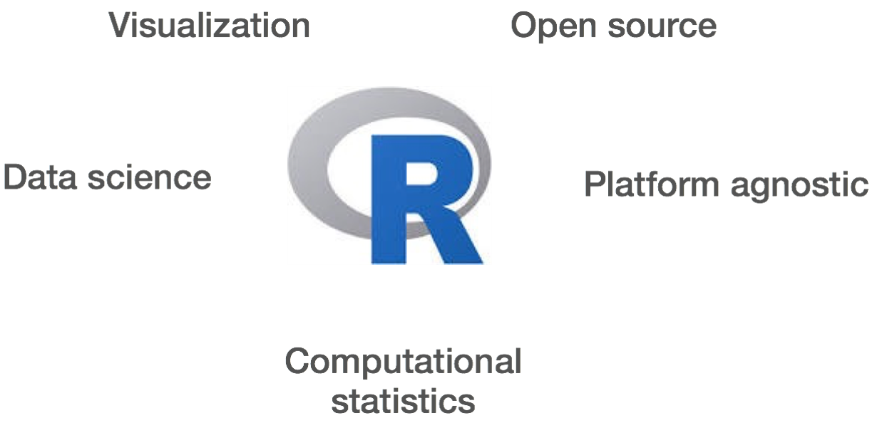

Slide 7
Home of R and help on R questions
Home of all things R: https://cran.r-project.org/
Keep R updated – check for new versions
To get help:
Google the question or error message is always a good start
https://stackoverflow.com/questions/tagged/r

Slide 8
R Studio
Working environment R
While you do not need R Studio to run R, it makes working with R much easier
Just like R, it works on PC, Mac & Linux

Slide 9
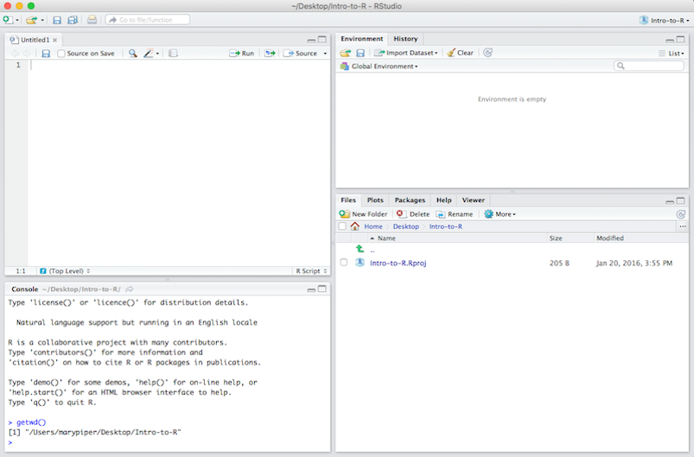

Slide 10
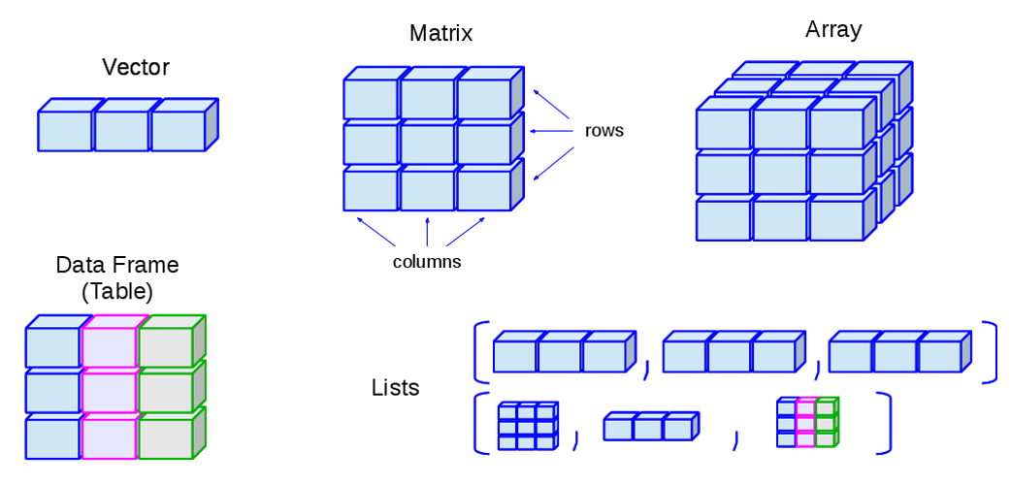
R-Syntax, data structures and types
http://venus.ifca.unican.es/RIntro/dataStruct.html

Slide 11
Data structures and types
Vectors: one-dimensional; store collection data of same mode; one coordinate to identify a unique vector element):
Numeric vectors (mode: numeric)
Logical vectors (mode: logical)
Character vector or vector of strings (mode: character)
Factors are vectors for categorical variables that assign a label to each category
Matrices: two dimensional, store data of same mode; two coordinates to identify a unique matrix element
Arrays: n-dimensional; store data of same mode; n coordinates needed to identify a unique array element
Lists: ordered collection of objects, elements can be of different types
Data frames: Matrices that can store data of different modes
For Analysis: Always place observations in rows & variables in columns
Call missing values for numeric mode NA and for string mode “”

Slide 12
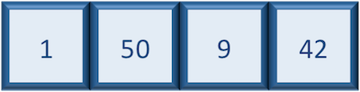
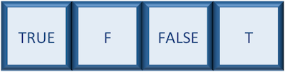

Vectors
Numeric vectors
a <- 5
a <- c(1, 50, 9, 42)
Logical vectors
b <- a < 10
Character vectors
a <- “this is text”

Slide 13
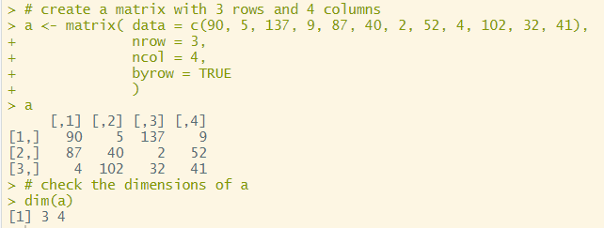
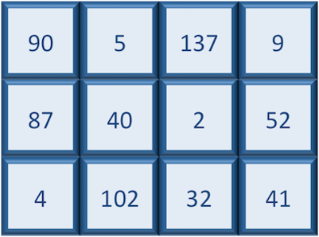
Matrix

Slide 14
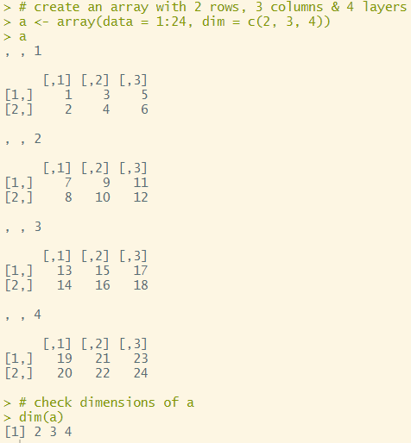
Array

Slide 15
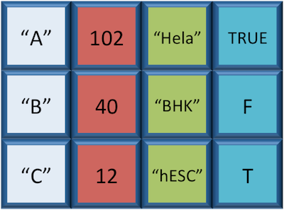
Data frame
Each row is a vector
Each column is a vector
All rows must have equal length
All columns must have equal length

Slide 16
Data frame
We will use data frames for analysis
Data frames can store different data modes (numeric, factor, character)
Data frames are rectangular
All rows have the same length
All columns have the same length

Slide 17
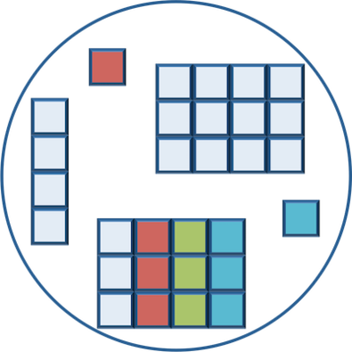
List
Lists hold any number of any types of other data structures
If you have variables of different data structures you wish to combine you can put all of those into one list object by using the list() function and placing all the items you wish to combine within parentheses:
a <- list( object1, object2, object3)

Slide 18
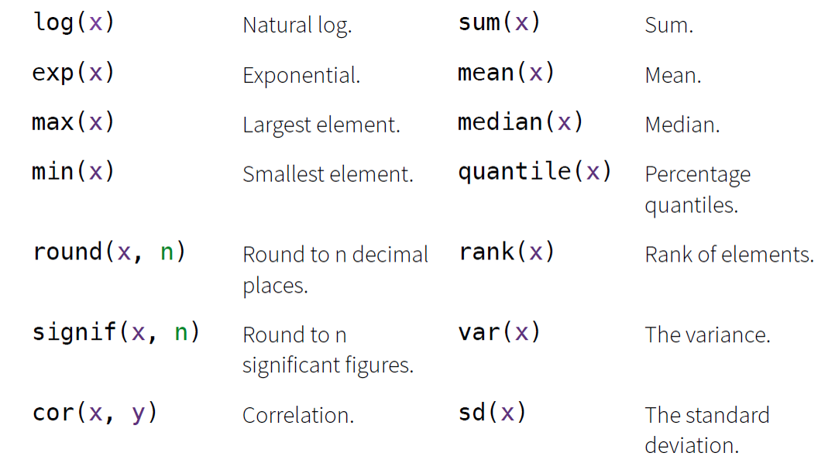
Math functions

Slide 19



Thank you
Join in the conversation online:
@BLGDataResearch #Data2Life
LinkedIn: ESRC Business and Local Government Data Research Centre
YouTube: ESRC Business and Local Government Data Research Centre
Email: BLGDataResearch@essex.ac.uk

